Slide 1

Shri Govindram Seksaria Institute of Technology and Science
Computer Science and Engineering
MAJOR PROJECT PRESENTATION
Presented By-
Abhijeet Chouhan
Abhishek Lovanshi
Anuj Nevatia
Gaurav Gupta
Vinayak Agrawal
Guide-
Mr.Surendra Gupta
Co-Guide-
Ms. Himani Ma’am

Slide 2
Hateful Memes Classification
Machine Learning Algorithm
Integration in Telegram bot

Slide 3
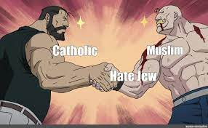
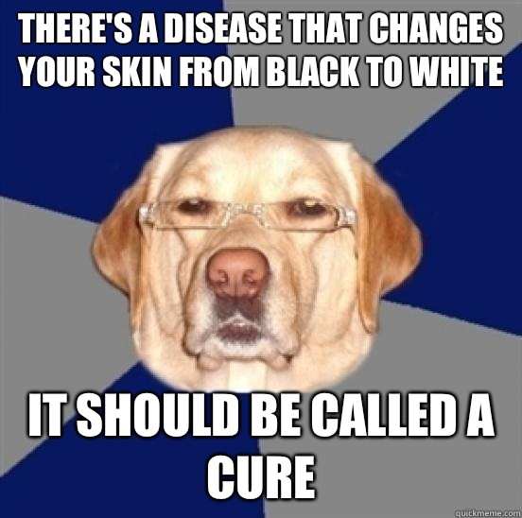
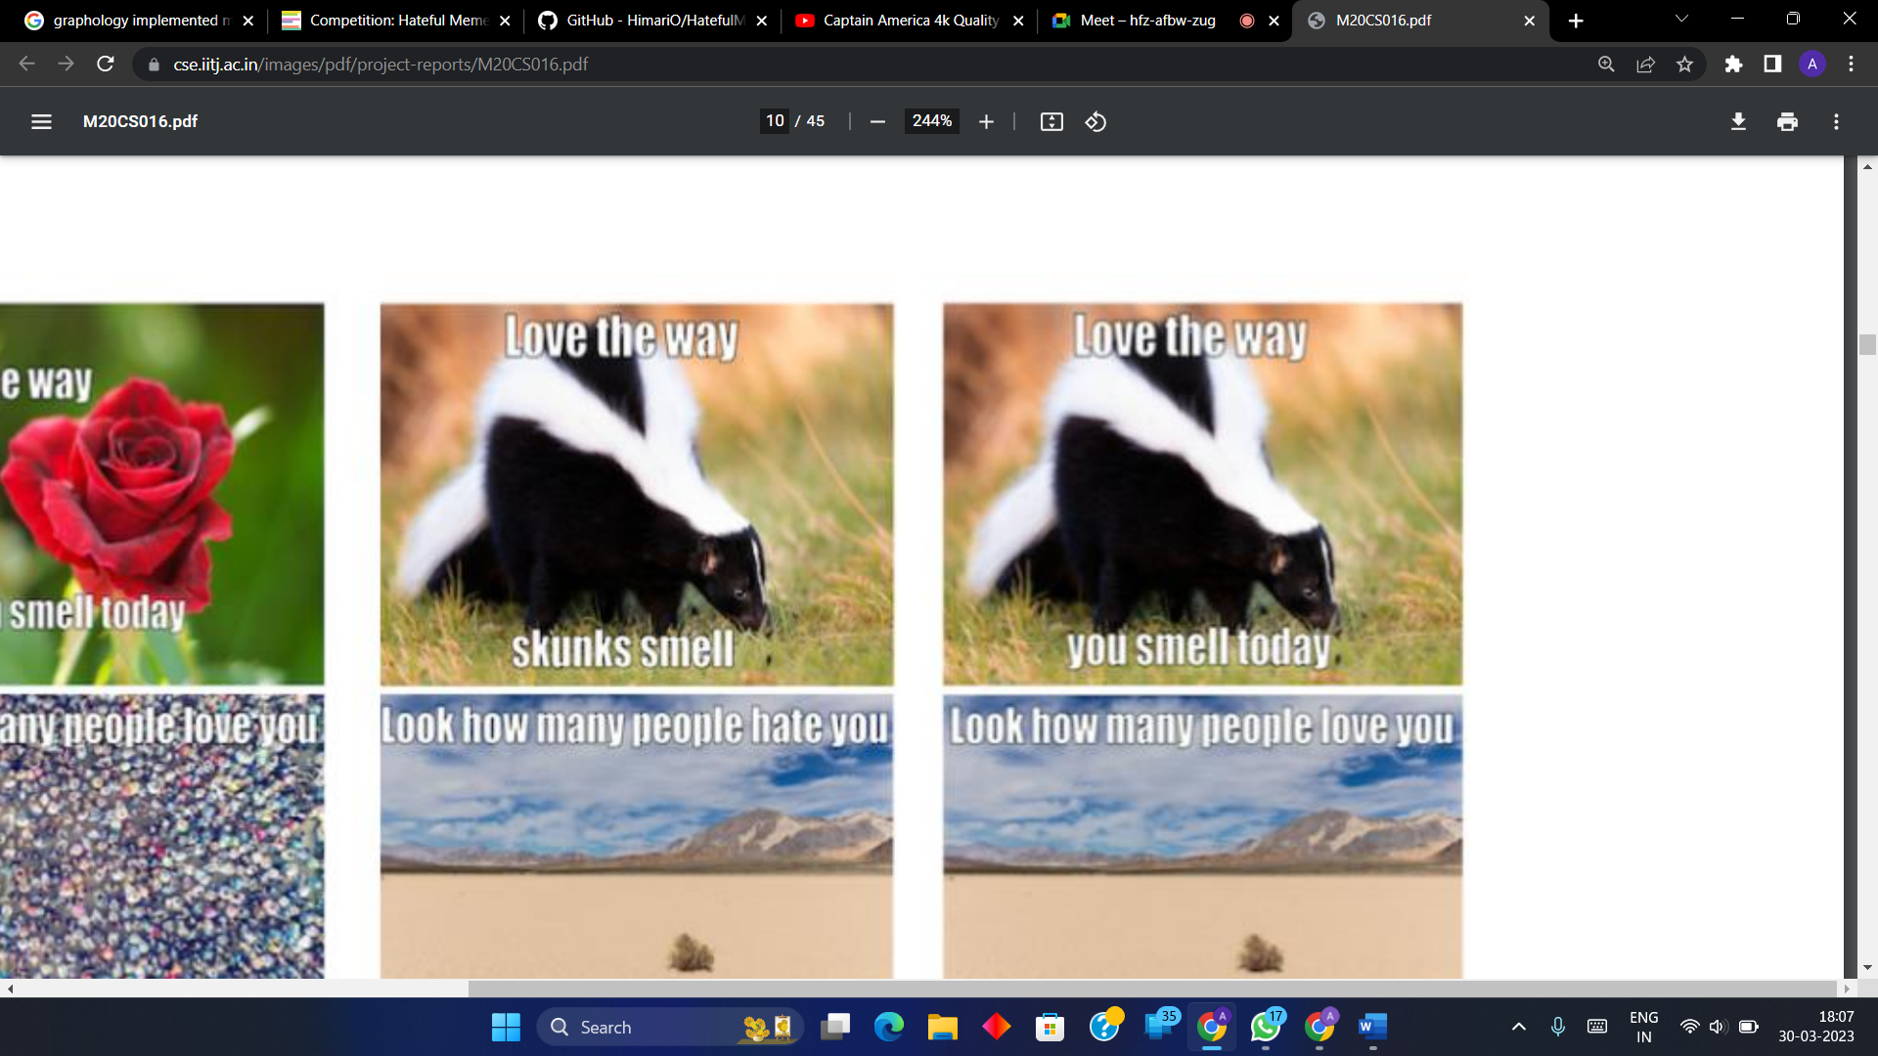
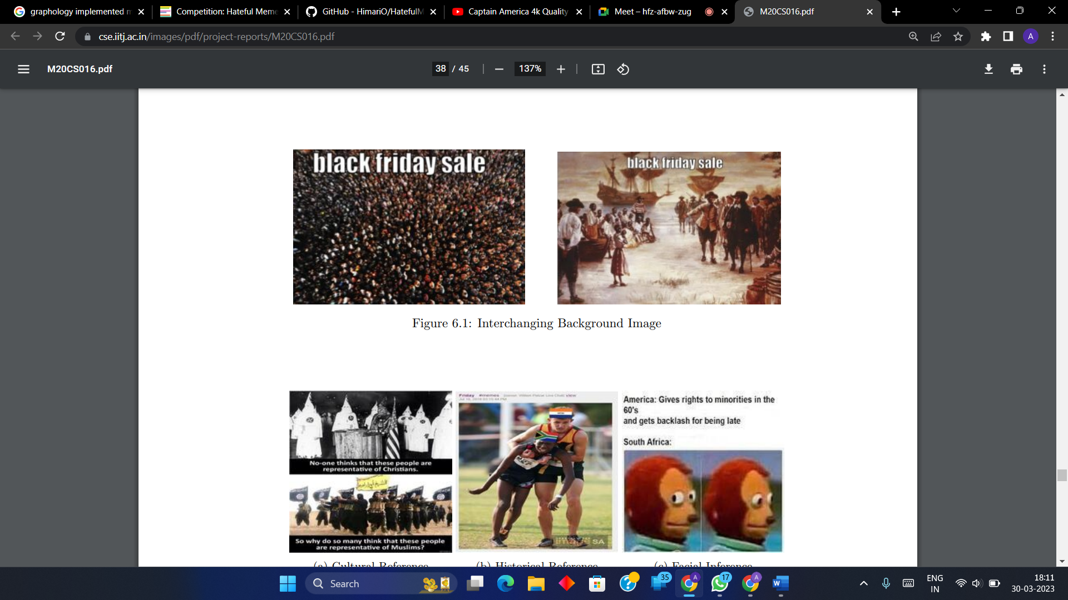
Hateful Memes

Slide 4
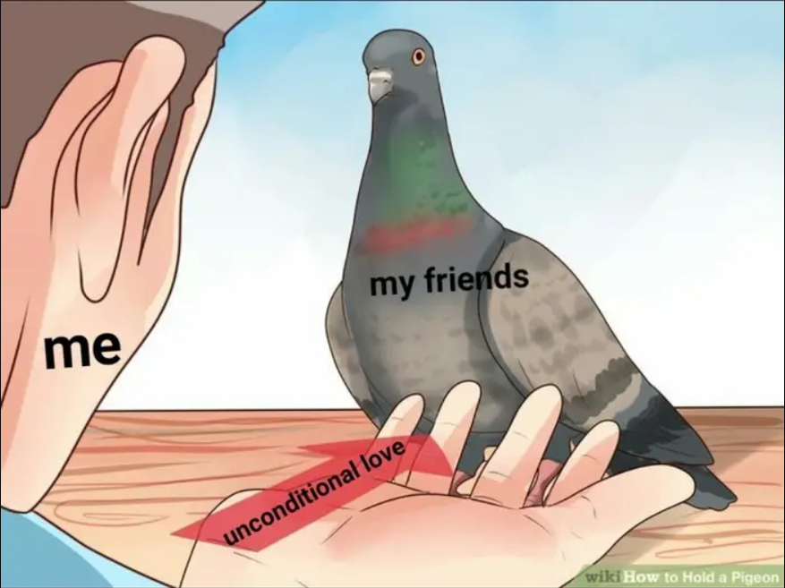
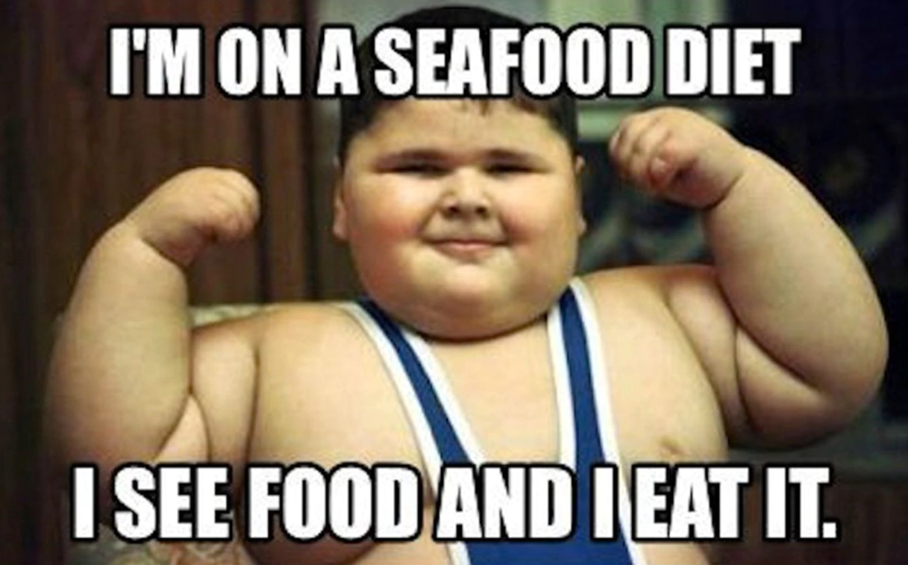
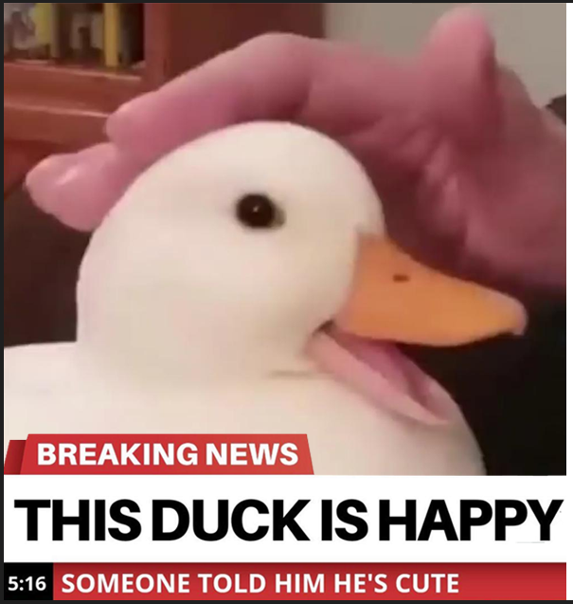
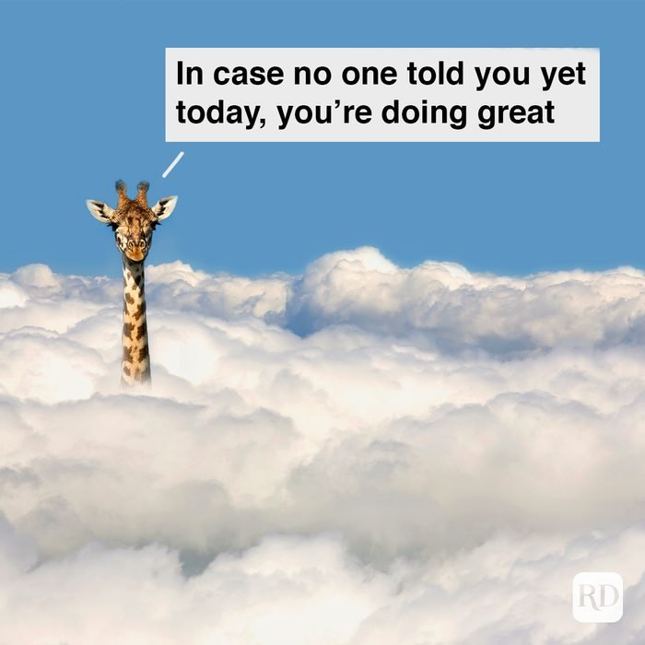
Benign Memes

Slide 5
Problem Statement
There is an increase in the amount toxicity present on social media platforms specially in the form of memes, monitoring and moderating such platforms is too expensive and time consuming of a task to do manually.

Slide 6
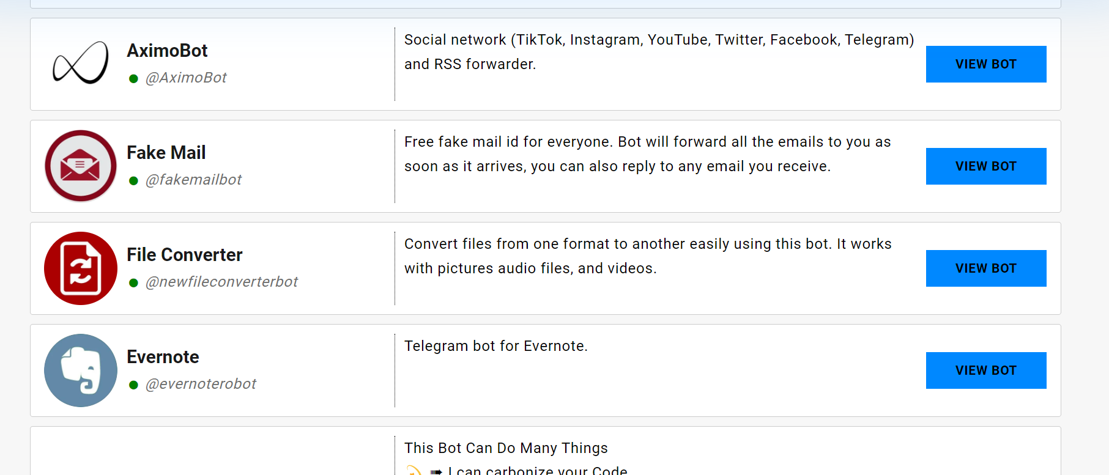
Existing Telegram Bots

Slide 7
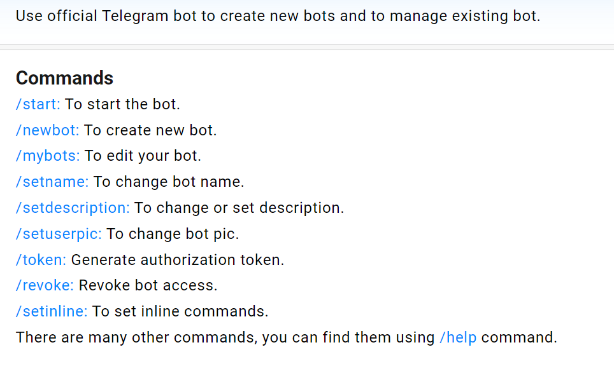

Slide 8
Our Solution
Develop a machine learning algorithm that can classify memes as hateful or non-hateful. The algorithm should be able to analyze both the image and text present in the meme. The dataset used for training and testing the model is provided by Facebook AI for its hateful memes challenge. Once the model is trained, it should be integrated into a Telegram bot that can classify an image sent on the group as hateful or non-hateful.

Slide 9
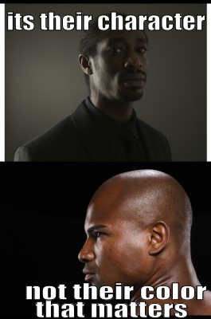
Hateful Meme
its their character not their color that matters

Slide 10
Image Feature Extraction
Features map of the Image
Resize
Passed to CNN Model where series of filters are applied on the image
265X400
224X224
Passed through pooling layers
Features map of the Image
Reduced Size features map of the Image
Flattened as a single vector and passed to fully connected n/w

Slide 11
Text Feature Extraction
i love everything and everybody ! except for squirrels i hate ‘squirrels’.
i love everything and everybody except for squirrels i hate squirrels
love everything everybody except squirrels hate squirrels
Normalize Text
Remove Stopwords
Tokenization
Features map of the text
Each token will be now mapped to vector representation.
“love” “everything” “everybody” “except” “hate” “squirrels”
These sequence of vectors now passed into an fasttext model
Embedding

Slide 12
Fusion
Features map of the text
Features map of the Image
Combined features map of both image and the text
X
Element wise addition
Final
Combined features map of both image and the text
After passing the above feature map as input to further layers to highlight important combinations of features and suppress less important ones

Slide 13
Late Fusion
Image feature extraction
Classifier
Image/ Text
feature fusion
Hateful
Image
Text feature extraction
Classifier
Benign
Early Fusion
Image feature extraction
Image/ Text
feature fusion
Classifier
Hateful
Image
Text feature extraction
Benign

Slide 14
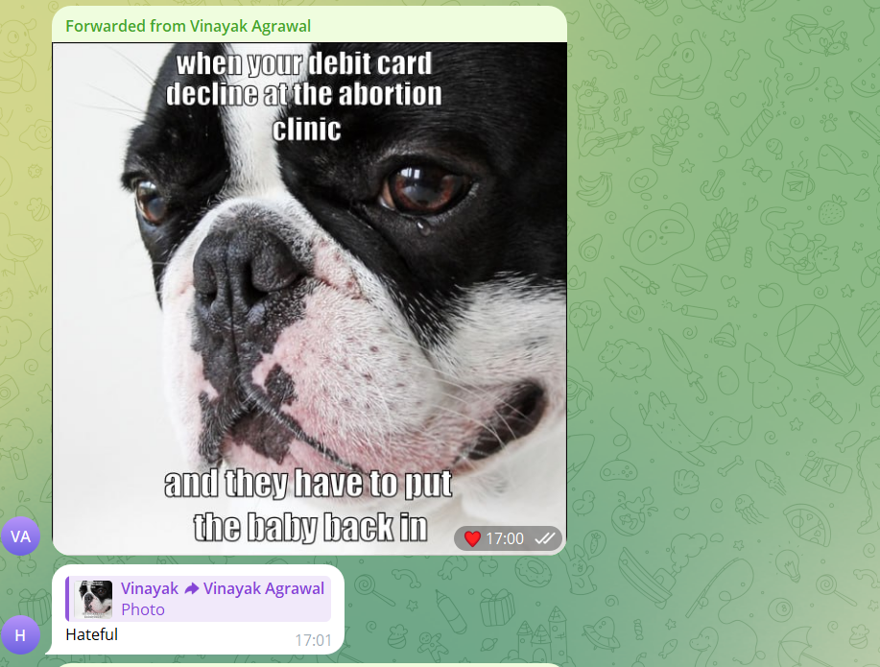

Slide 15
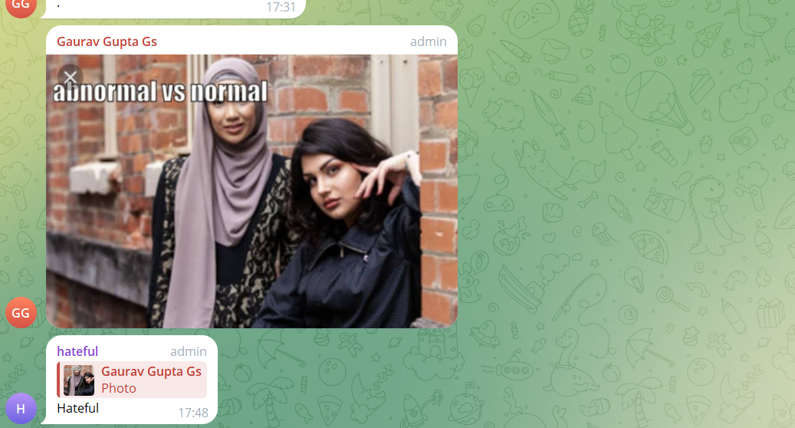

Slide 16
